Slide 1
Data Science Programming
Deepayan Chakrabarti (deepay@utexas.edu)
Notes:
Today’s class is an intro to the rest of the course.
Why Analytics? Is it hype? Will it go away?
Businesses need to make decisions ➔ where to allocate resources, how much inventory, customer segmentation, pricing
Earlier, managers did it just by gut feel, because there wasn’t much data to go by
Two big changes
Data storage became cheap ➔ computerization of data entry, store data in a “warehouse”
data analysis ➔ On Line Transaction Processing (banks), and On Line Analytics Processing (OLAP) to analyze the stored data
It’s only now that we have so much data available that analysis is feasible for many problems
Why is it hard?
Data analysis is often an iterative process.
Even figuring out what is the right question, or the right place to look (e.g., “FB losing users” ➔ is it true? Where (Germany?), which demographic (teens?), why (Snapchat? privacy), and finally what to do about it (what aspect of current product needs improvement? UI? Latency issues?)
Which standard tool is most relevant, and what to do when it fails?
A business problem is not the same as just a technical problem (Business problem: losing customers. Tech problem: optimal pricing)
Why should a manager care?
Iterative process ➔ Need understanding of both the business side and the technical side ➔ Having both types of skills is hard

Slide 2
Why Analytics? Is it hype?
Businesses need to make decisions
Earlier: Manager’s gut feel
Two big changes
Cheap storage
New tools
Online Transaction Processing (OLTP)
Online Analytical Processing (OLAP)
Data collection and processing became important

Slide 3
Why is it hard?
Why not just “hire a software developer”?
Data analysis is iterative
Unlike software development
A business problem is different from a technical problem
Example: “FB losing users”
Really?
Which demographics?
Why? Privacy? Parents on FB? Latency issues? Too many memes?
What can we do about it?
Finding the right technical question to ask is difficult
What tools can we use to solve this problem?
What if the standard tools fail?
Notes:
We need to understand both the business side and the technical side

Slide 4
What’s this about?
Big Data
Insights
… is where all the buzz is.
Who “liked” what posts?
Who friended/followed whom?
Who clicked on what news stories?
How do we improve News Feed?
How can we only show relevant ads?
How do we help people find their friends online?
… where the money is.
Notes:
Say, for a company like Facebook: Communication patterns; who messaged whom? How often? When? In a group or not? Logged in on Android, iPhone, or desktop?
Insights = actionable items.

Slide 5
What’s this about?
Big Data
Insights
That line is tangled
“Big”
but it isn’t really about how many data centers the company has
How is the data I have is related to the insights I want?
Notes:
Making anything scale to a very large dataset is a problem. Often a significant problem. But it’s not just about throwing more computers at it. It isn’t really about how many data centers the company has.

Slide 6
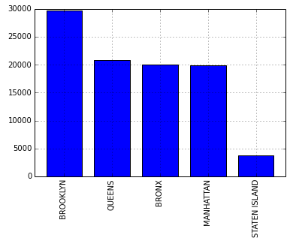
What’s this about?
Big Data
Insights
How is the data I have is related to the insights I want?
“How should I distribute law enforcement units throughout New York?”
Look at the number of complaints from each Borough
Notes:
Depends on precinct locations, manpower issues, robbery vs theft vs homicide, etc. The question does not have a point-and-click solution. Yet, each individual question is not difficult in isolation. ITERATIVE process.

Slide 7
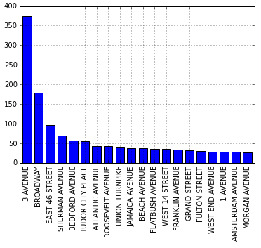
What’s this about?
Big Data
Insights
How is the data I have is related to the insights I want?
“I’m visiting New York and I hate noise. What should I avoid?”
Aggregate noise complaints around each street
Notes:
Current travel sites can’t deal with niche requests

Slide 8
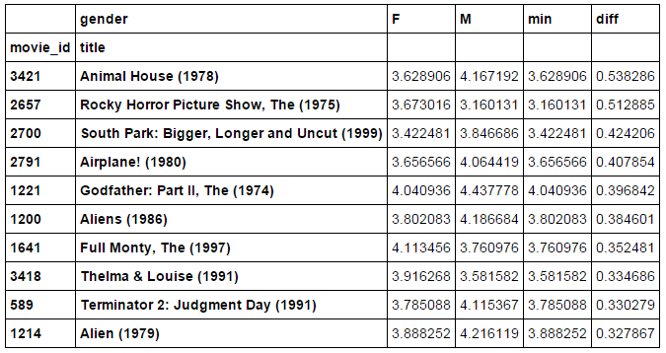
What’s this about?
Big Data
Insights
How is the data I have is related to the insights I want?
“What movies are rated very differently by men and women?”

Slide 9
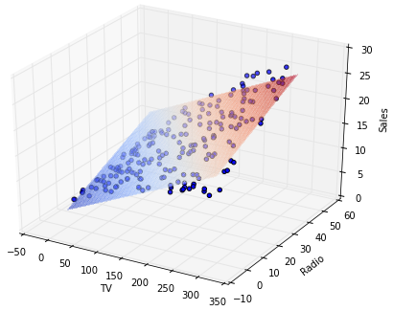
What’s this about?
Big Data
Insights
How is the data I have is related to the insights I want?
“How is advertising on TV, Radio, and Newspapers related to sales?”
TV and Radio matter, Newspapers not at all (!)

Slide 10
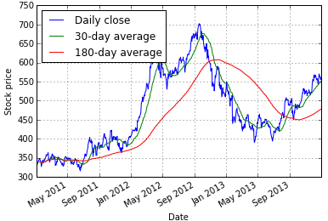
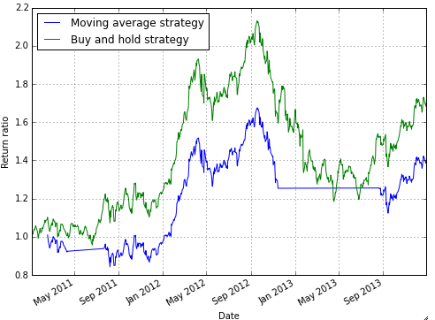
What’s this about?
Big Data
Insights
How is the data I have is related to the insights I want?
“How well does a trading strategy work?”

Slide 11
What’s this about?
Big Data
Insights
How is the data I have is related to the insights I want?
Exploratory data analysis
“Does the data look right?”
“How do we analyze relationships between variables?”
“How does the data change depending on user groups?”
Leads to a concrete problem
(asking the right questions)

Slide 12
What’s this about?
Big Data
Insights
How is the data I have is related to the insights I want?
Exploratory data analysis
“Does the data look right?”
Concrete problem
“Ads for computer tech support vendors are getting swamped by ads for computer manufacturers.”
“Important posts from friends are being swamped out by memes on News Feed”
Notes:
Advertisers of computer tech support are getting swamped out by ads from computer manufacturers. How do you fix this?
(2) Memes in News Feed. How do you fix News Feed? Identify cat pictures. Classify post a meme or not…

Slide 13
What’s this about?
Big Data
Insights
How is the data I have is related to the insights I want?
Get the data
From websites
From APIs
(never quite in the form we need)
Notes:
Twitter, Instagram and others have APIs for Python.

Slide 14
What’s this about?
Big Data
Insights
How is the data I have is related to the insights I want?
Get the data
Munge it into shape (“data wrangling”)
Remove mistaken entries
Fill in missing values
Example: Text analysis
remove stop-words (“a”, “an”, “the”, “she”)
stem remaining words (“car” and “cars” are the same)
merge synonyms?
Notes:
“Car crash” versus “vehicle collision”

Slide 15
What’s this about?
Big Data
Insights
How is the data I have is related to the insights I want?
Get the data
Munge it into shape (“data wrangling”)
Visualization
Drill-downs into the data
Look at specific groups within the data
“How does the Facebook user experience differ based on the number of friends?”
Notes:
Drill-down ➔ look at specific groups within the data

Slide 16
What’s this about?
Big Data
Insights
How is the data I have is related to the insights I want?
Get the data
Munge it into shape (“data wrangling”)
Visualization
Drill-downs into the data
Specific analysis techniques
Classification: “which customers are likely to switch to a competitor?”
Clustering: “how can I group customers by their behavior?”
Notes:
Classification: churn prediction for mobile operators, recommending books, or movies.
Clustering: Groups of users to advertise to (e.g., sharing a certain interest)

Slide 17
What’s this about?
Big Data
Insights
This course is about
(primarily) the tools to work with data and do the analysis
(secondarily) gaining a working knowledge of the tool internals
Specifically, data analysis with Python

Slide 18
Why Python?
Indeed, many possibilities
R
really good for statistical analyses
Matlab
really good optimization and other toolkits
preferred by many machine learning and signal processing researchers
C and C++
general-purpose language
super fast, scales easily
useful for back-end production-level code
Difficulty: you need all of the above

Slide 19
Why Python
Getting data
Need to work with APIs, web
Python has libraries for it
Munging it
A lot of string processing and regular expression tools
Base python
Visualization and exploratory analysis
Python libraries numpy, pandas, matplotlib
Classification and clustering
Python libraries scikit-learn, statsmodel
Reasonably general-purpose
Really extensible
Used heavily in industry
Notes:
Huge userbase

Slide 20
Logistics
M T W Th
3 group assignments
Each group will have 2 or 3 students, assigned randomly
Group project with presentation
Each group will have 4 students, assigned randomly
Pick any topic of interest
Write a detailed report
literature survey
data analysis
Present in class

Slide 21
Logistics
M T W Th
3 group assignments
Group project with presentation
Final exam
Open-book, Open-notes,
Open-Google,
Open-web

Slide 22
Tentative schedule
The schedule is posted on Canvas
Tentatively:
Introductory Python ➔ 3 lectures
Values, variables, control flow
Data structures
String manipulation

Slide 23
Tentative schedule
The schedule is posted on Canvas
Tentatively:
Introductory Python ➔ 3 lectures
Using Pandas ➔ 8 lectures
Series and DataFrames
Data wrangling
Visualization
Split data into groups
Time series and statistics

Slide 24
Tentative schedule
The schedule is posted on Canvas
Tentatively:
Introductory Python ➔ 3 lectures
Using Pandas ➔ 8 lectures
Regression, Classification, and Clustering ➔ 5 lectures
Basic probability and classification
Nearest neighbors
Naïve Bayes
Decision trees
K-Means clustering

Slide 25
Tentative schedule
The schedule is posted on Canvas
Tentatively:
Introductory Python ➔ 3 lectures
Using Pandas ➔ 8 lectures
Regression, Classification, and Clustering ➔ 5 lectures
Project presentations
August 9th and 10th
Final exam
TBA (August 13th –ish)

Slide 26
Logistics
Grading
3 group assignments (3 * 15% = 45%)
1 group project with presentation (25%)
1 final (30%)
Notes:
Group work counts for 65%.

Slide 27
Logistics
Tentative schedule on canvas; has more details
Reading materials (all optional):
Introductory Python: Think Python, by Downey
Exploratory Analysis: Python for data analysis, by Wes McKinney
Machine learning basics: Applied Predictive Modeling, by Max Kuhn and Kjell Johnson
A variety of online sources

Slide 28

Logistics
TA
Alek Dimitriev
Office hours
Me: Monday 12:45-1:45
Alek: Tuesday 9-10
Set up an appointment
deepay@utexas.edu (me)
alekdimi@utexas.edu (TA)
(attendance)

Slide 29
Setting up Python
Python setup the easy way:
Anaconda Python distribution:
https://www.anaconda.com/download
Get the version for Python 3.x
Enthought Canopy distribution:
https://store.enthought.com/
Fill out the forms to get an academic license
Download Canopy
Notes:
These come with all the necessary packages and modules installed.

Slide 30
Setting up Python
Python setup details:
We will use Python 3.x
(not Python 2.7; there are some differences not worth the time)
You can install multiple versions of Python on your laptop
Notes:
Both Canopy and Anaconda install these by default, and make it easy to upgrade the packages.

Slide 31






Setting up Python
Python setup details:
We will need the following packages:
Notes:
Both Canopy and Anaconda install these by default, and make it easy to upgrade the packages.

Slide 32
Setting up Python
How to run Python
The Jupyter shell
For interactive testing of statements
Type jupyter on the command line
Can also run programs directly from the command line
python filename.py
will run the python code in filename.py
Jupyter notebook
Combine code, results, and text in one webpage
Run jupyter notebook on the commandline

Slide 33
Setting up Python
Most of the code I show will be in notebook form
For assignments, you will create notebooks
Combines code, plots, and text

Slide 34
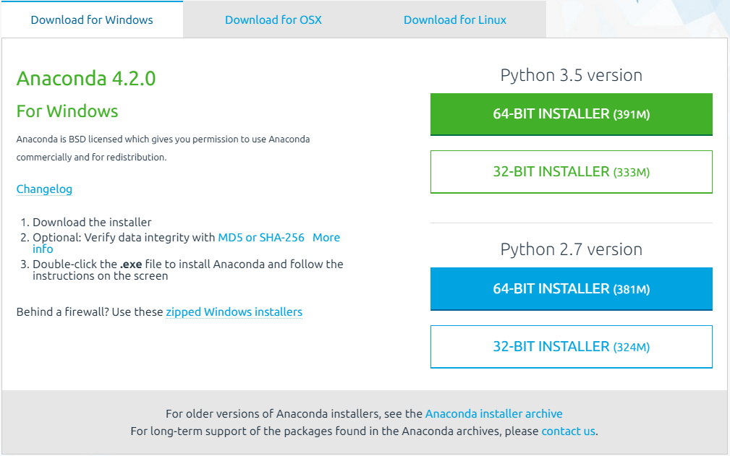
How to create Python notebooks
First, install Python (search for anaconda python)

Slide 35
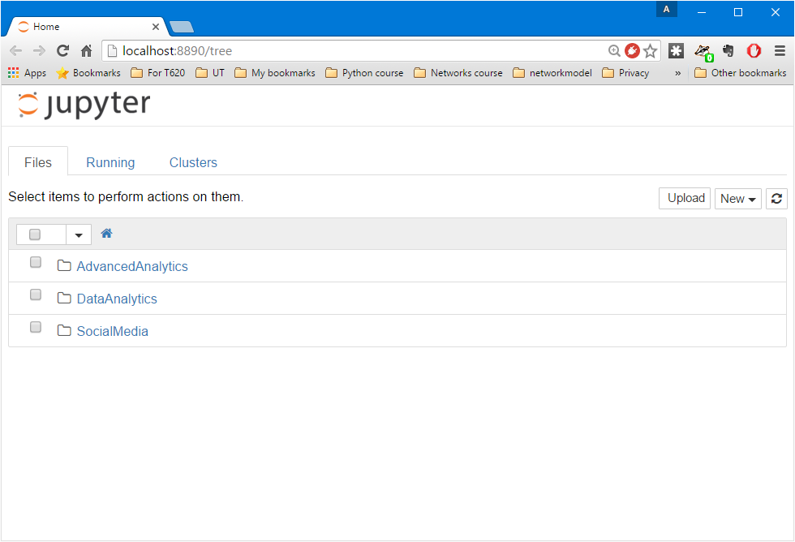
How to create Python notebooks
On the command-line, run:
jupyter notebook

Slide 36
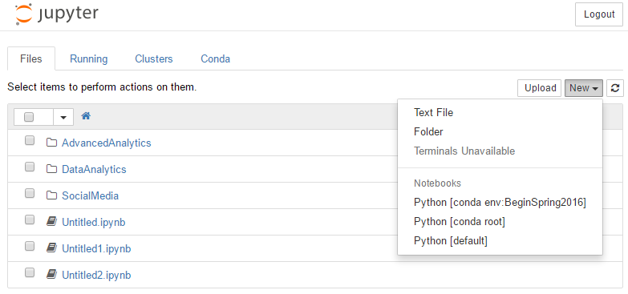
How to create Python notebooks
On the command-line, run:
jupyter notebook

Slide 37
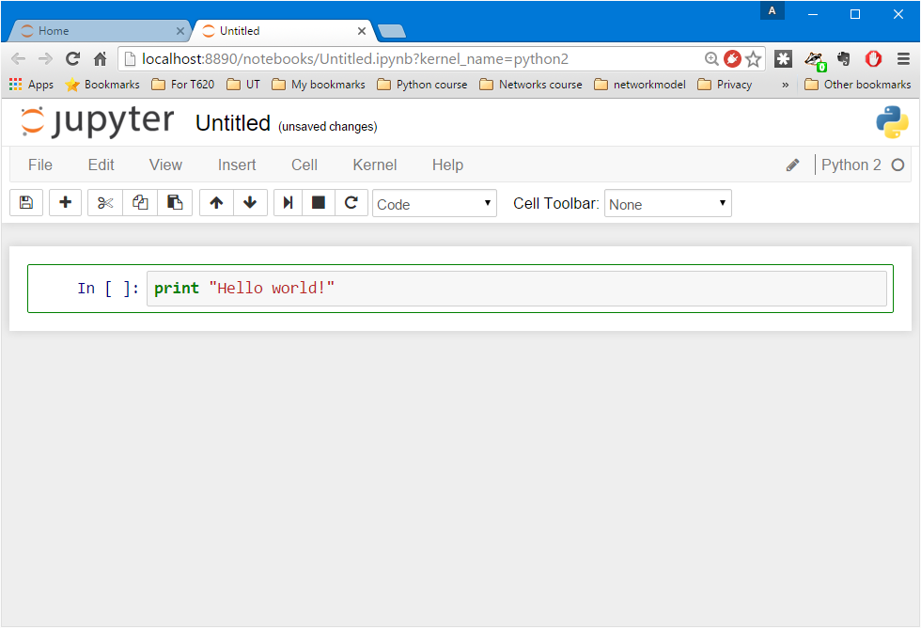
How to create Python notebooks
Change the name of the notebook
Write some code here; then hit Alt-Enter

Slide 38
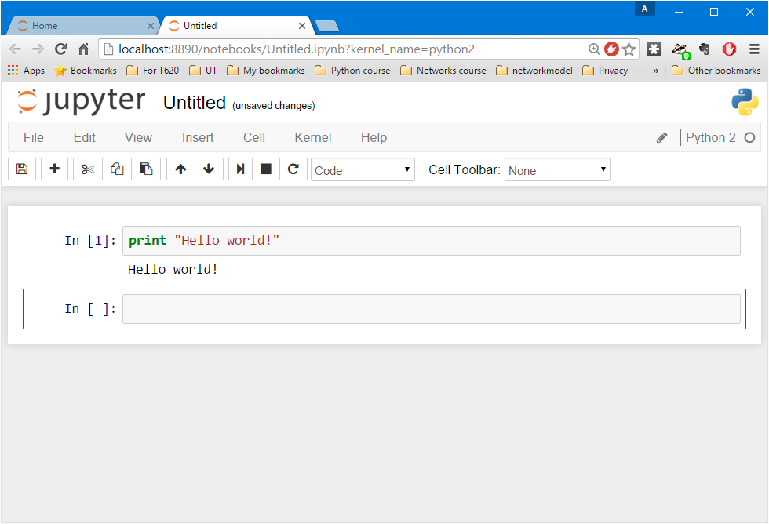
How to create Python notebooks
Change the cell type to “Markdown”
Output of the code
New cell

Slide 39
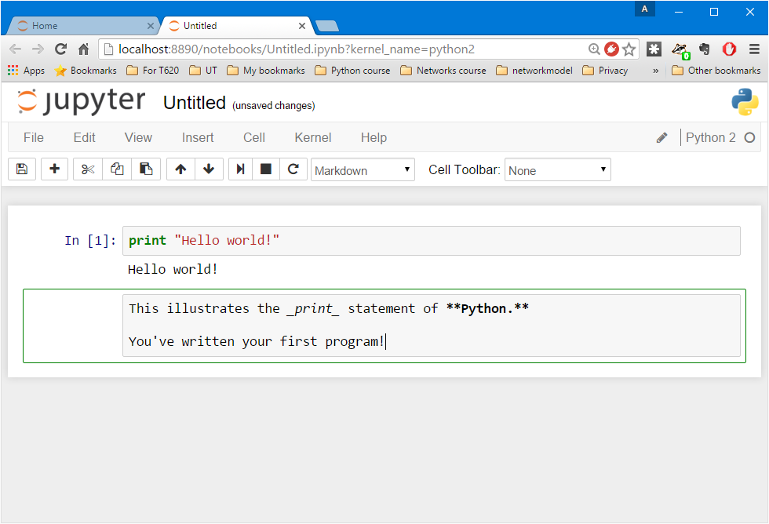
How to create Python notebooks
This cell is now interpreted as “Markdown”, which is text with
_italics_
**bold**
and many other options
Again, hit Alt-Enter

Slide 40
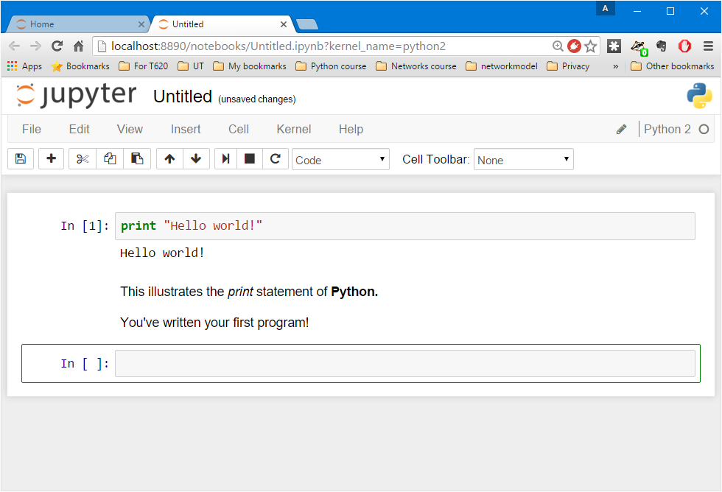
How to create Python notebooks
The Markdown cell gets converted into italicized and bolded text

Slide 41
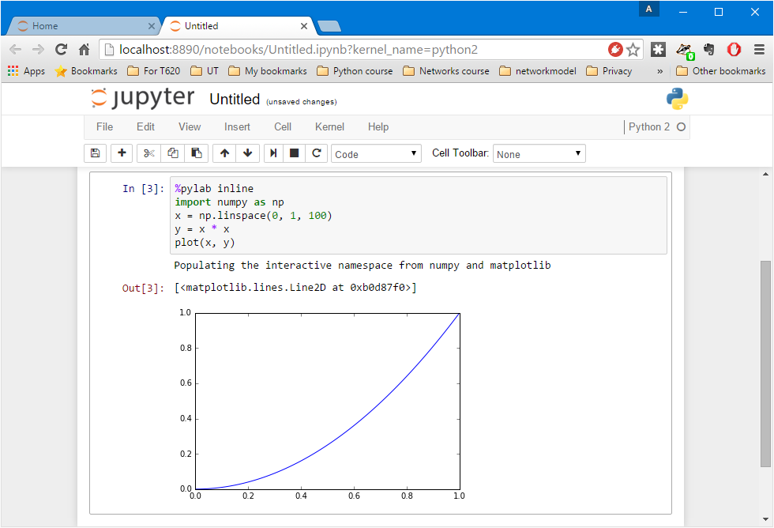
How to create Python notebooks
Save when you’re done!
Figures generated by your code are easily shown

Slide 42
One final bit
This course
Data
Analysis / Decision
Base Python
Exploratory Analysis
Classification toolkits
Statistical Models
Machine Learning Theory
Optimization for model inference

Slide 43
One final bit
We learn Python so as to get to the good stuff
Analysis
Visualization
Data mining and machine learning
I cannot teach you all of Python
Ask Google and StackOverflow ☺

